Slide 1
Intermediate Code Generation + Code Optimization
Compiler Construction

Slide 2
Review of Compiler Construction
Compiler as a translator:
___________
| |
source language -------| COMPILER |---> target language
| __________|
A compiler is a program which reads in a program in a source language and translates it into a program (often executable) in a target language .
An interpreter reads in a source program and produces the result of running that program.
Clearly much of the technology required for compiling is required to produce an interpreter ...
Examples:
  C, PASCAL, PL/1, FORTRAN, ... are usually compiled languages
  SCHEME, PROLOG, MIRANDA, HASKELL, ML, ... are usually interpreted languages (most also have compilers)
  JAVA, CLEAN compile to bytecodes which are then interpreted/compiled to specific architectures.

Slide 3
Review of Compiler Construction
A compiler is usually just one step in a number of steps which lead to the production of "absolute machine code" ... however it is perhaps the biggest step!
___________ _________ __________ ______
| | | | | | | |
->- | preprocess |-->--| compile |-->--| assemble |-->-- | link |->
|__________| |___ ______| |_________| |_______|
source source assembler re-locatable absolute
object code machine code

Slide 4
THE STEPS OF COMPILING
Example of an expression:
position := initial + rate * 60
The first question one must ask is whether this is a valid expression in the given source language. For this we need
  A formal definition of the language
  An effective membership test
  A plan for how to handle failure (i.e. error recovery!)

Slide 5
THE STEPS OF COMPILING
Usually the syntax of a languages is specified in two stages:
  a specification of the lexemes of the language (that is the substrings of the input which will have special significance to the compiler) and their correspondence to the tokens ...
  a specification of the grammar of the language based on tokens (obtained by translation from the lexemes) which are the terminal symbols of the language. This is usually done by providing a context free grammar

Slide 6
THE STEPS OF COMPILING
STEP 1: Lexical analysis (micro syntax -- regular expressions)
Group characters together to form lexemes which are translated into tokens which are the terminals of the grammar used in the next step.
  Lexeme→Token
  "127“→INT(000000001111111)“
  length" →ID("length")
  "+“→ADD
This can be efficiently implemented using deterministic finite automata (DFA).
These are often specified using "patterns" which are essentially regular expressions.

Slide 7
THE STEPS OF COMPILING
STEP 2: Syntactic analysis (macro syntax - context free)
  The structure of the language is defined by a context free language and it is determined whether the stream of tokens belong to the grammar.

Slide 8
THE STEPS OF COMPILING
STEP 3: Semantic analysis (meaning --- type checking!)
  Consider again the assignment
  position := initial + rate * 60
  Does this syntactically legal expression actually mean anything? How do we tell?
  are "position", "initial", and "rate" declared?
  what is "60"?
  what is the meaning of "+" and "*"?
  can "position"'s value be assigned in this way?

Slide 9
THE STEPS OF COMPILING
STEP 4: Intermediate code generation
At this stage we know that we have a legal program.
Our next step may be to generate an intermediate representation of the code: this representation should be sufficiently close to machine code that it facilitates the translation to machine code and yet sufficiently high level that it facilitates optimization.
A typical intermediate code is "three address code".
Each instruction in this code is a simple assignment consisting of an assigned variable a binary or unary operation and its two arguments.
The above assignment might translate to:
temp1 := int2real(60)
temp2 := id3 * temp1
temp3 := id2 + temp2
id1 := temp3

Slide 10
THE STEPS OF COMPILING
STEP 5: Optimization of intermediate code
The intermediate representation is optimized:
  constant folding: expressions just involving constants can be evaluated at compile time
  elimination of unnecessary intermediate variables (e.g. temp3 is an unnecessary intermediary ).
  common sub expression elimination
  strength reduction of operations (e.g. multiplying by 2 changed into a shift of bits)
  code movement out of loops ...
These procedures applied to the above code may have the following effect:
temp2 := id3 * 60.0
id1 := id2 + temp2

Slide 11
THE STEPS OF COMPILING
STEP 6: Code generation Intermediate code is translated to a suitable assembler code.
E.g.
ld [%fp-16],%f4
ld [%fp-12],%f3
sethi %hi(.L_cseg2),%l0
or %l0,%lo(.L_cseg2),%l0
ld [%l0+0],%f2
fmuls %f3,%f2,%f2
fadds %f4,%f2,%f2
st %f2,[%fp-8]

Slide 12
THE STEPS OF COMPILING
STEP 7: Assembler optimizations
In generating assembler there are a number of important issues:
  Register allocation: if you can do the computation with a fewer load/store instructions this may produce better code. To achieve this involves deciding how best to use the registers available to you on your target machine.
  Load latency: when you load a value into a register from store because instructions are pipelined in most modern processors the value is not immediately available for use ... thus one may need to rearrange statements so that there are some operations between when the value is loaded and when the register is used.

Slide 13
Compiler Construction
QUALITIES OF A COMPILER ..
  Correctness (does it preserve meaning -not as easy as it sounds but it is very important!)
  Compiles quickly (complexity of compiling program O(n log n) )
  Output execution speed (how fast is the output code?)
  Output footprint (how large is the code how much memory does it use?)
  Separate compilation (relocatable code, linking)
  Use friendly front-end: good error recovery.
  Debugging facilities.
  Cross language calls -- interface compatibilities.
  Understandable optimizations.

Slide 14
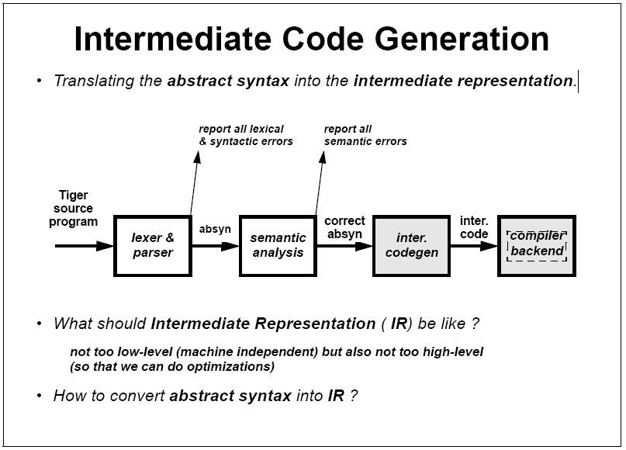

Slide 15
Intermediate Code Generation
Generates something between machine code and the high-level language.
Tends not to specify every register to use, etc.
This code can be easily optimized by the next phase

Slide 16
Intermediate Code Generation
Depending on the compiler, this step may be skipped, and instead the program may be translated directly into the target language (usually machine object code).
If this step is implemented, the compiler designers also design a machine independent language of there own that is close to machine language and easily translated into machine language for any number of different computers.

Slide 17
Intermediate Code Generation
The purpose of this step is to allow the compiler writers to support different target computers and different languages with a minimum of effort.
The part of the compiler which deals with processing the source files, analyzing the language and generating the intermediate code is called the front end, while the process of optimizing and converting the intermediate code into the target language is called the back end.

Slide 18
Intermediate Code Generation
The input to the code generator typically consists of a parse tree or an abstract syntax tree.
The tree is converted into a linear sequence of instructions, usually in an intermediate language such as three address code.
Further stages of compilation may or may not be referred to as "code generation", depending on whether they involve a significant change in the representation of the program.

Slide 19
Intermediate Code Generation
The design of an intermediate language typically differs from that of a practical machine language in three fundamental ways:
  Each instruction represents exactly one fundamental operation; e.g. "shift-add" addressing modes common in microprocessors are not present.
  Control flow information may not be included in the instruction set.
  The number of registers available may be large, even limitless.
A popular format for intermediate languages is three address code.

Slide 20
Three-address code
A form of representing intermediate code used by compilers to aid in the implementation of code-improving transformations. Each instruction in three-address code can be described as a 4-tuple: (operator, operand1, operand2, result).
Each statement has the general form of:
x := y op z
where x, y and z are variables, constants or temporary variables generated by the compiler. op represents any operator, e.g. an arithmetic operator.
Expressions containing more than one fundamental operation, such as:
P := x + y * z
are not represent able in three-address code as a single instruction. Instead, they are decomposed into an equivalent series of instructions, such as
t1 := y * z
p := x + t1
The term three-address code is still used even if some instructions use more or fewer than two operands. The key features of three-address code are that every instruction implements exactly one fundamental operation, and that the source and destination may refer to any available register.

Slide 21
Code Optimization
Code optimization tends to try and optimize speed of execution or reduce program size.
Examples include:
  re-arranging loop structures.
  optimizing expression evaluation.

Slide 22
Code Optimization
During this process the code generated is analyzed and improved for efficiency.
The compiler analyzes the code to see if improvements can be made to the intermediate code that couldn't be made earlier.
For example, some languages like Pascal do not allow pointers, while all machine languages do.
When accessing arrays, it is more efficient to use pointers, so the code optimizer may detect this case and internally use pointers.

Slide 23
Why use intermediate languages?
Simplify the compilation phase
  ultimately leads to a more efficient code
Portability of the compiler front-end
Reusability of the compiler back-end
C++
C++
Pentium
Pentium
Java
Java
MIPS
MIPS
C
IR
C
Pascal
Sparc
Sparc
Pascal
ML
ML

Slide 24
Types of Intermediate Languages
High Level Representations (e.g., syntax trees):
  synthesize the syntactic information gathered during the parse, generally in the form of a tree or directed graph.
  closer to the source language
  easy to generate from an input program
  code optimizations may not be straightforward but enables high level code optimizations
Low Level Representations (e.g., 3-address code):
  low-level coded representation of the program directly translatable to object code.
  closer to the target machine;
  easier for low-level, architecture-dependent optimizations and final code generation;

Slide 25
Concepts - Intermediate Code Generation
Intermediate codes are machine independent codes, but they are close to machine instructions
The given program in a source language is converted to an equivalent program in an intermediate language by the intermediate code generator
Intermediate language can be many different languages, and the designer of the compiler decides this intermediate language e.g.
  Syntax trees
  Postfix notation
  Three-address code
Some programming languages have well defined intermediate languages
  java – java virtual machine
  prolog – Warren abstract machine
  In fact, there are byte-code emulators to execute instructions in these intermediate languages

Slide 26
Understanding Intermediate Representations

Slide 27
1. Syntax Tree

Slide 28
1. Syntax Tree
Depicts the natural hierarchical structure of a source program.
Consider the following assignment statement
  a := b * -c + b * -c;

Slide 29
Learn by Example
  a := b * -c + b * -c;
assign
a
b * -c + b * -c

Slide 30
Learn by Example
  a := b * -c + b * -c;
assign
a
+
b * -c
b * -c

Slide 31
Learn by Example
  a := b * -c + b * -c;
assign
a
+
*
*
b
-c
b
-c

Slide 32
Learn by Example
  a := b * -c + b * -c;
assign
a
+
*
*
b
uminus
b
uminus
c
c

Slide 33
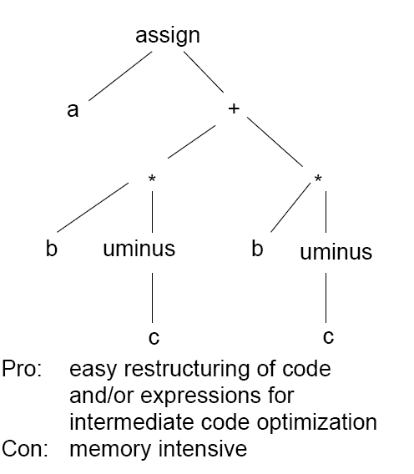
Finally, we have

Slide 34
Learn by Doing
Make a syntax tree for the following assignment statement
  x:= a*b + c*d – e*f
assign
x
+
-
*
a
b
*
*
c
d
e
f

Slide 35
Two Representations of Syntax Tree

Slide 36
Representation using records & pointers
Each node is represented as a separate record having three fields
  Operator
  Left child
  Right child
Parent node is linked to its children using pointers in the record field.

Slide 37
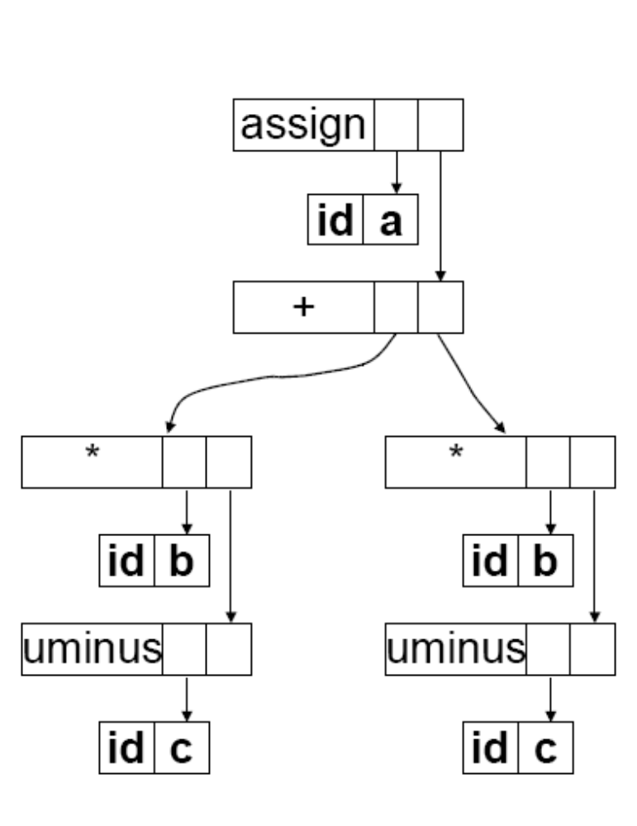
Learn by Example (a:=b*-c + b*-c)
assign
a
+
*
*
b
uminus
b
uminus
c
c

Slide 38
Learn by Doing (x:=a*b+c*d–e*f)
assign
?
x
+
-
*
a
b
*
*
c
d
e
f

Slide 39
Representation using arrays & indexes
Nodes are allocated from an array of records.
Index of the node serves as the pointer to the node.

Slide 40
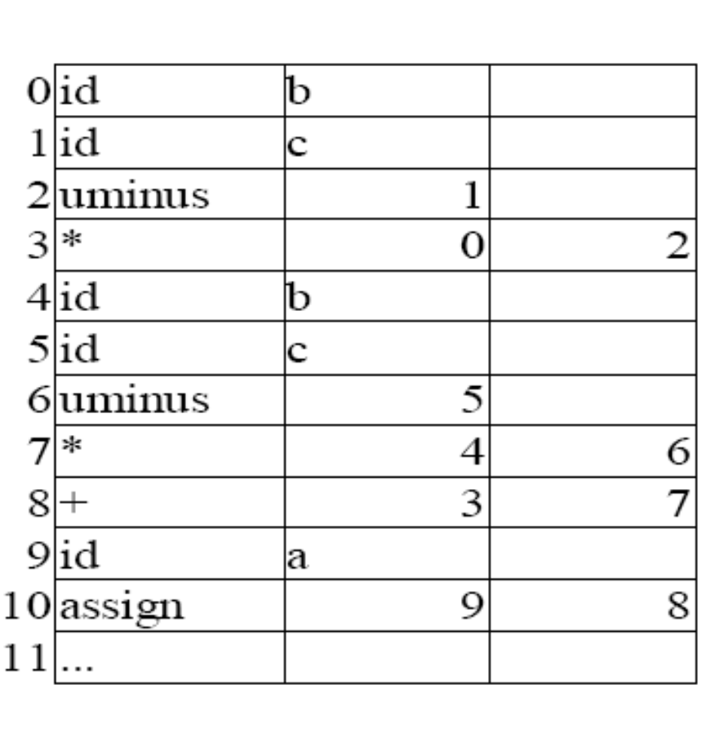
Learn by Example (a:=b*-c + b*-c)
assign
a
+
*
*
b
uminus
b
uminus
c
c

Slide 41
Learn by Doing (x:=a*b+c*d–e*f)
assign
assign
?
?
x
x
+
+
-
-
*
*
a
a
b
b
*
*
*
*
c
c
d
d
f
e
f
e

Slide 42
2. Postfix Notation

Slide 43
Postfix Notation
Its nature allows it to be evaluated with the use of a stack
Operands are pushed onto the stack; operators pop the right amount of operands from the stack, do the operation, then push the result back onto the stack.
However, this notation is restricted to simple expressions such as in arithmetic where every rule conveys an operation
It cannot be used for the expression of most programming languages constructs

Slide 44
Postfix Notation
Every expression is rewritten with its operators at the end, e.g.:
Can be generated from a syntax tree using post order traversal
a+b ⇒ ab+
a+b*c ⇒ abc*+
x=a*b+a*b ⇒ ab*ab*+x=

Slide 45
Learn by Example
assign
a
+
*
*
b
uminus
b
uminus
c
c
Postfix Notation
a b c uminus * b c uminus * + assign

Slide 46
Learn by Doing
assign
x
+
-
*
a
b
*
*
c
d
e
f
Postfix Notation
x a b * c d * e f * - + assign

Slide 47
3. Three Address Code

Slide 48
Three-Address Code
Three-address codes (3AC) is an intermediate language that maps directly to assembly code, but that is not architecture-dependent
It breaks the program into short statements requiring no more than three variables and no more than one operator, e.g:
source
3AC
x = a+b*c t := b*c
x := a+t

Slide 49
Three-Address Code
The name for this intermediate representation is Three Address Code because each statement usually contains three addresses, two for the operands and one for the result.
The temporary variables are generated at compile time and added to the symbol table

Slide 50
Learn by Example (a:=b*-c + b*-c)
t1 := -c
t2 := b * t1
t3 := -c
t4 := b * t3
t5 := t2 + t4
a := t5

Slide 51
Learn by Doing (x:=a*b+c*d–e*f)
t1 := a*b
t2 := c*d
t3 := e*f
t4 := t2 – t3
x := t1 + t4

Slide 52
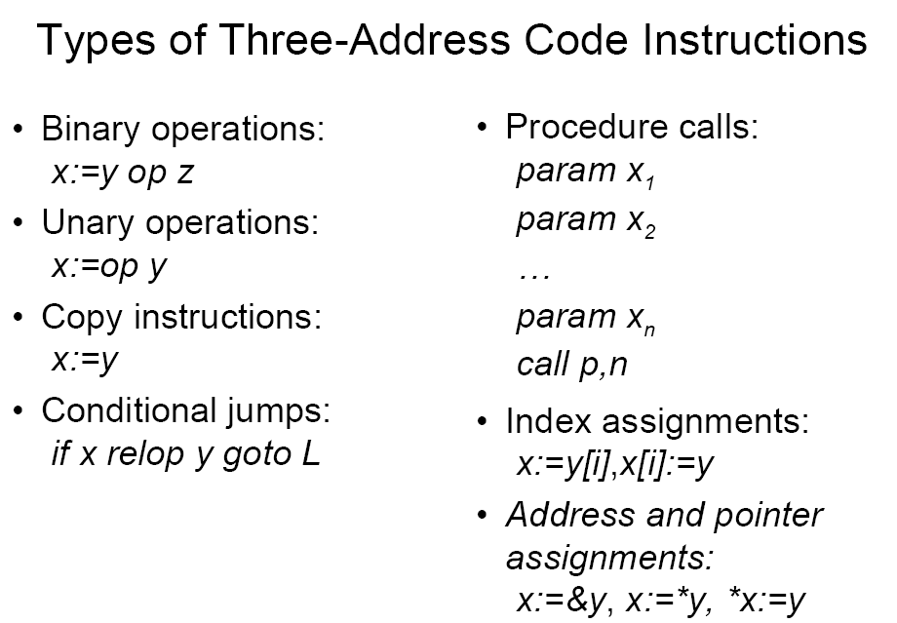

Slide 53
Implementation of Three Address Statements
3AC is an abstract form of intermediate code.
In a compiler, these statements can be implemented as records with fields for the operator and the operands. It can be done in the form of
  Quadruples
  Triples
  Indirect Triples ( Not to be covered yet)

Slide 54
Quadruple Representation of 3AC
A quadruple is a record structure of four fields
  operator
  argument 1
  argument 2
  result
The contents of fields arg1, arg2 and result are pointers to the symbol table entries for the names represented by these fields
Therefore, temporary names must be added in the symbol table.

Slide 55
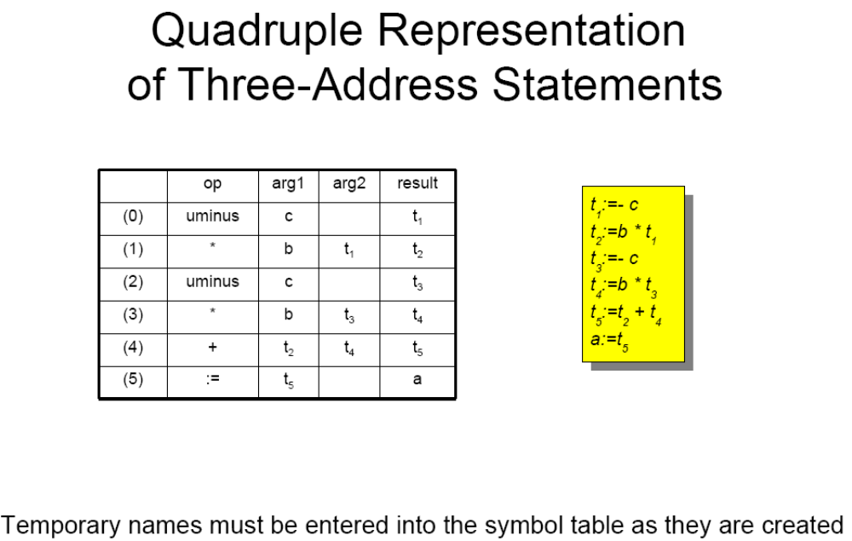

Slide 56
Learn by Doing
x:=a*b+c*d–e*f
Write 3AC for the assignment statement and store in a quadruple

Slide 57
Triple Representation of 3AC
A quadruple is a record structure of three fields
  operator
  argument 1
  argument 2
The contents of fields arg1, arg2 and result are either pointers to the symbol table entries for the names represented by these fields or pointers into the triple structure for temporary values
Therefore, temporary names need not be added in the symbol table.

Slide 58
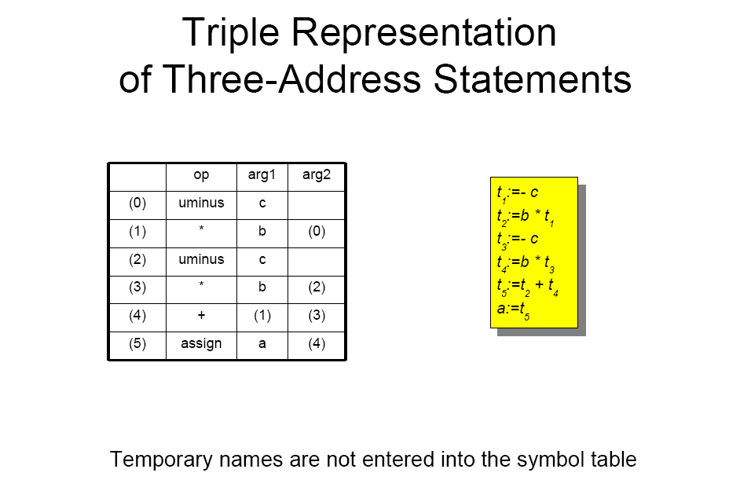

Slide 59
Learn by Doing
x:=a*b+c*d–e*f
Write 3AC for the assignment statement and store in a triple

Slide 60
Let’s Revise !!

Slide 61
Types of Intermediate Languages
High Level Representations (e.g., syntax trees):
  synthesize the syntactic information gathered during the parse, generally in the form of a tree or directed graph.
  closer to the source language
  easy to generate from an input program
  code optimizations may not be straightforward but enables high level code optimizations
Low Level Representations (e.g., 3-address code):
  low-level coded representation of the program directly translatable to object code.
  closer to the target machine;
  easier for low-level, architecture-dependent optimizations and final code generation;

Slide 62
Understanding Intermediate Representations
1. Syntax Tree
  a := b * -c + b * -c;
assign
a
+
*
*
b
uminus
b
uminus
c
c

Slide 63
Two Representations of Syntax Tree

Slide 64
Understanding Intermediate Representations
2. Postfix Notation
  a := b * -c + b * -c;
a b c uminus * b c uminus * + assign

Slide 65
Understanding Intermediate Representations
3. Three Address Code
  a := b * -c + b * -c;
t1 := -c
t2 := b * t1
t3 := -c
t4 := b * t3
t5 := t2 + t4
a := t5

Slide 66
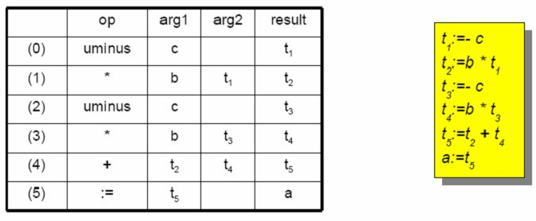
Implementation of Three Address Statements
  Quadruples
  a := b * -c + b * -c;

Slide 67
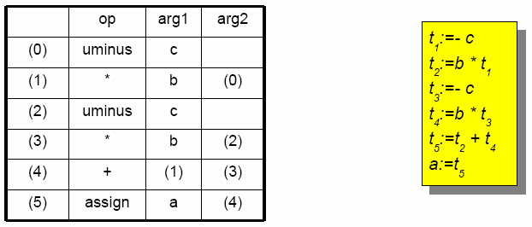
Implementation of Three Address Statements
  Triples
  a := b * -c + b * -c;

